Slide 1
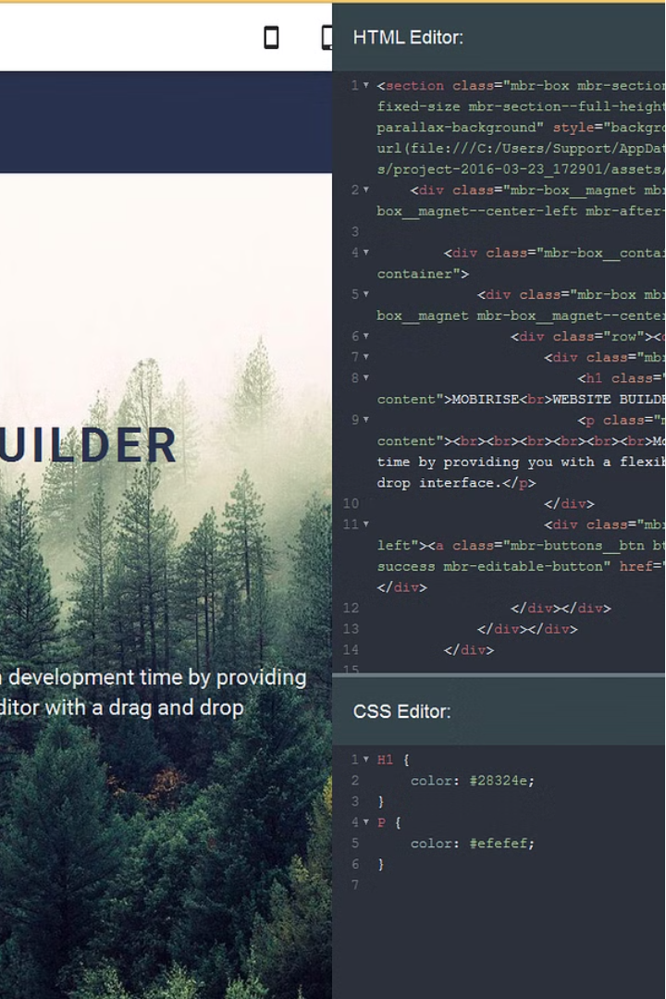
Introduction to HTML
HTML, or Hypertext Markup Language, is the standard language used to create and structure web pages. It provides a way to define the content, layout, and functionality of a web page through a series of tags and elements.

Slide 2
What is HTML?
Purpose
Structure
Flexibility
HTML is the building block of the World Wide Web, allowing web developers to create and publish content on the internet.
HTML uses tags and elements to define the different parts of a web page, such as headings, paragraphs, images, and links.
HTML can be combined with other web technologies, like CSS and JavaScript, to create more advanced and interactive web pages.
HTML stands for Hyper Text Markup Language
HTML is the standard markup language for creating Web pages
HTML describes the structure of a Web page
HTML consists of a series of elements
HTML elements tell the browser how to display the content
HTML elements label pieces of content such as "this is a heading", "this is a paragraph", "this is a link", etc.

Slide 3
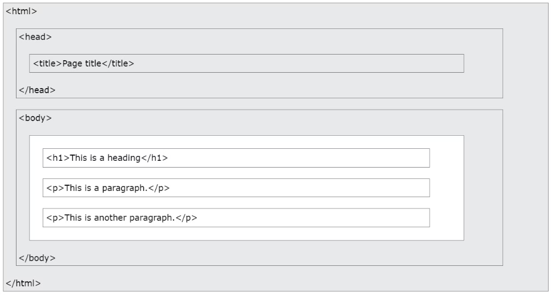
The <!DOCTYPE html> declaration defines that this document is an HTML5 document
The <html> element is the root element of an HTML page
The <head> element contains meta information about the HTML page
The <title> element specifies a title for the HTML page (which is shown in the browser's title bar or in the page's tab)
The <body> element defines the document's body, and is a container for all the visible contents, such as headings, paragraphs, images, hyperlinks, tables, lists, etc.
The <h1> element defines a large heading
The <p> element defines a paragraph

Slide 4

HTML Structure
1
<!DOCTYPE HTML>
The doctype declaration tells the web browser which version of HTML is being used.
2
<HTML>
The HTML element is the root element of the HTML document. It wraps all the content on the webpage.
3
<head>
This section contains meta-information about the document, such as its title, character encoding, and links to external resources like CSS stylesheets and JavaScript files.
4
<title> Page Title </title>
Title of HTML Page
5
</head>
6
<body>
This is where the main content of the webpage is contained. Everything visible on the webpage, such as text, images, and links, is placed within the body section.
7
</body>
8
</html>

Slide 5
Basic HTML Tags
1
Headings
2
Paragraphs
HTML provides six levels of headings, from H1 (largest) to H6 (smallest).
The
tag is used to define paragraphs of text.
3
Links
4
Images
The tag is used to create hyperlinks, allowing users to navigate between web pages.
The tag is used to insert images into a web page.

Slide 6
HTML Attributes
ID
Class
The id attribute uniquely identifies an HTML element on a web page.
The class attribute groups related HTML elements and allows for CSS styling.
Src
Href
The src attribute specifies the URL of an image, video, or other media file.
The href attribute defines the URL of a hyperlink, allowing users to navigate to other pages.

Slide 7



HTML Headings and Paragraphs
Headings
Paragraphs
Formatting
HTML headings, from H1 to H6, define the structure and hierarchy of a web page.
Paragraphs of text are enclosed within the
HTML provides tags like , , and to apply basic formatting to text.
tag, creating readable content.

Slide 8
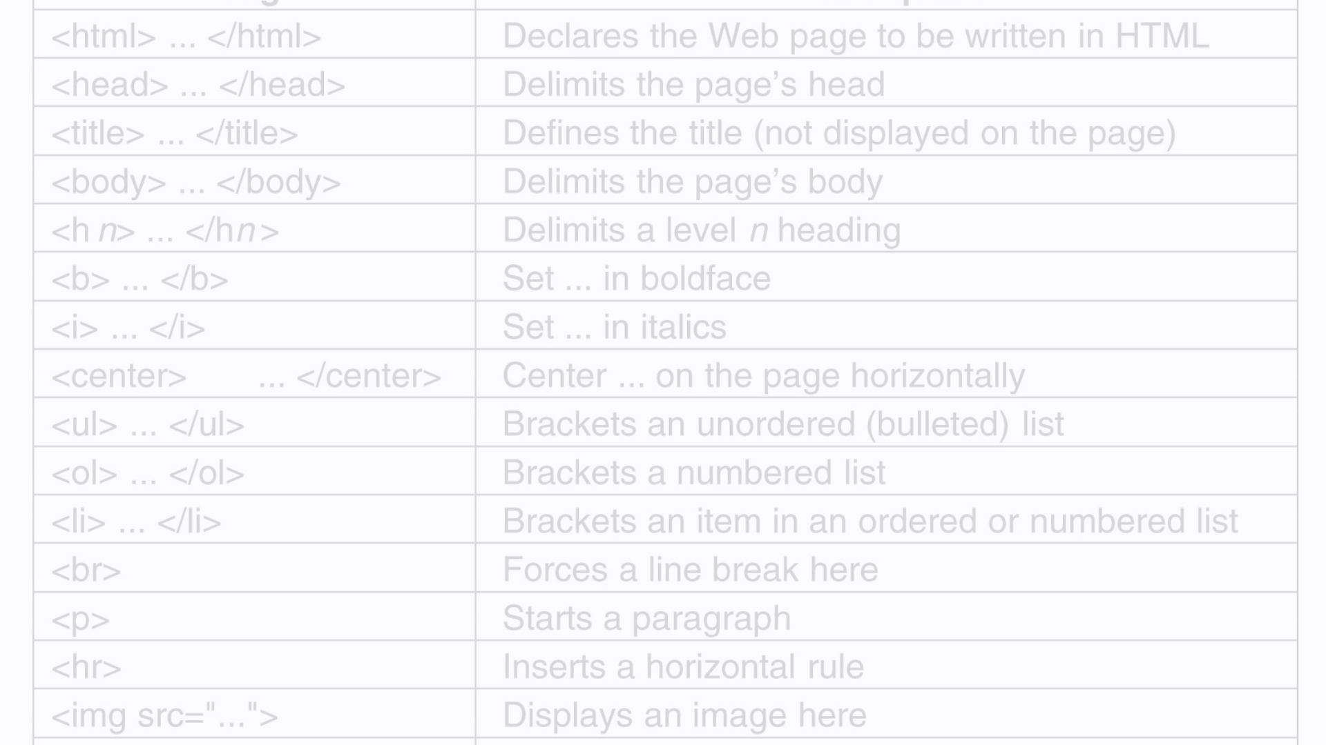



HTML Lists
Unordered Lists
Ordered Lists
List Items
Unordered lists, created with the
Ordered lists, created with the
Each list item is enclosed within the
tag, display items as bullet points.
tag, display items as numbered or lettered lists.

Slide 9
HTML Links
Link Type
Description
Internal Link
Links to other pages within the same website, using a relative URL.
External Link
Links to pages on other websites, using an absolute URL.
Mailto Link
Opens the user's default email client and pre-fills the recipient's email address.

